Slide 1

Developing Management Skills
Gaining Power and Influence

Slide 2
Learning Objectives
Enhance personal and position power
Use influence appropriately to accomplish exceptional work
Neutralize inappropriate influence attempts

Slide 3
Power: the capacity to influence behavior.
  The effective use of power and politics is a critical managerial skill.
  A manager’s power comes from helping others accomplish their tasks.
  This usually requires political clout.

Slide 4
Odes to Power
Power tends to corrupt, and absolute power corrupts absolutely. – Lord Acton
Power has only one duty – to secure the social welfare of the People. – Benjamin Disraeli
Political power grows out of the barrel of a gun.
– Mao Tse-Tung
I hope our wisdom will grow with our power, and teach us, that the less we use our power the greater it will be. – Thomas Jefferson
Power? It’s like a Dead Sea fruit. When you achieve it, there is nothing there. – Harold MacMillan
Power is given only to those who dare to lower themselves and pick it up. – Fyodor Dostoyevsky
Power is the great aphrodisiac. – Henry Kissinger

Slide 5
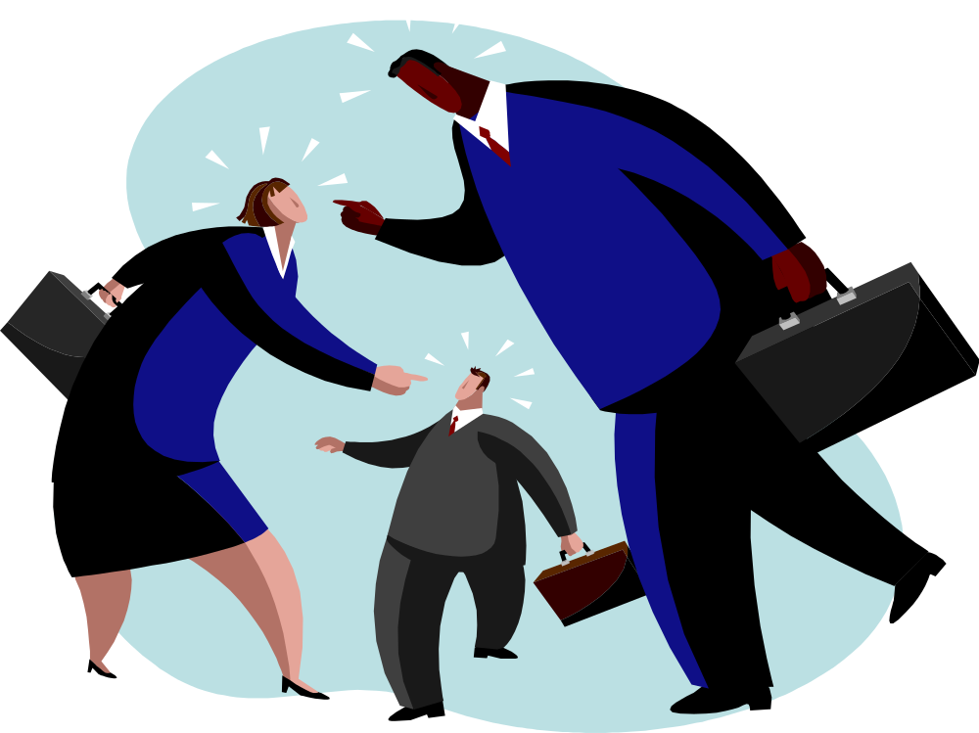
A Negative View of Power
Power has become a four-letter word.

Slide 6
A Positive View of Power
Power can lead to great good
It is the means through which managers accomplish work
It is the lack of power that can lead to unhappiness

Slide 7

  “Power has such a bad name that many good people persuade themselves they want nothing to do with it. . . . To say a leader is preoccupied with power is like saying that a tennis player is preoccupied with making shots her opponent cannot return”
  - J.W. Gardner

Slide 8
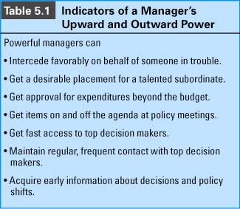

Slide 9
Characteristics that Derail Manager’s
Careers
Insensitive to others
Cold, aloof, and arrogant
Betraying others trust
Unable to delegate to others or to build a team
Overly dependent on others

Slide 10
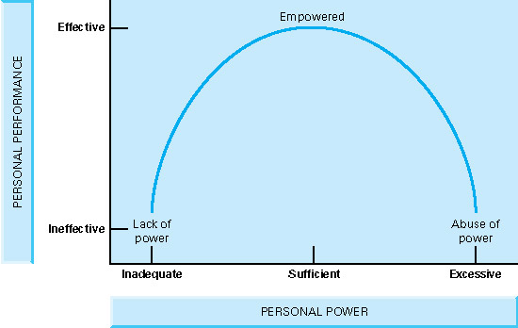
Personal Power: Stepping Stone or Stumbling Block
Insert figure 5.1

Slide 11
Current Trends
Organizations are now flatter
Technology has helped decentralized the flow of information
Organizational boundaries have become blurred
Increase in smaller firms

Slide 12

These trends have contributed to the use of empowerment, where power is based on managers’ abilities to perform, not their formal position.

Slide 13
Human Capital: an individual’s abilities and competencies.
Social Capital: a person’s social connections within and outside an organization.

Slide 14
Types of Power
High social capital (which is related to position power) puts employees in a better position to capitalize on human capital (which is related to personal power).

Slide 15
Sources of Personal Power
Expertise
Personal Attraction
Effort
Legitimacy

Slide 16

Expertise
Work related knowledge; comes from education, self-directed learning, and experience.

Slide 17

Personal Attraction
Based on charisma, agreeable behavior and physical characteristics.

Slide 18
Characteristics of Likable People
We like people when we have a reason to believe they will:
  Support an open, honest, and loyal relationship
  Foster intimacy by being emotionally accessible
  Provide unconditional, positive regard and acceptance
  Endure some sacrifices if the relationship should demand them
  Provide social reinforcement in the form of sympathy or empathy
  Engage in the social exchanges necessary to sustain a relationship

Slide 19

Effort
A desirable quality in employees
Can be related to expertise
Is viewed as a sign of commitment and dedication.

Slide 20
Legitimacy
Taking action congruent with the prevailing value system; focuses on the “hows” and “whys” of doing business the right way.

Slide 21
Sources of Position Power
Centrality
Flexibility
Visibility
Relevance

Slide 22
Centrality
Access to information in a communication network. Power is accrued via horizontal and vertical relationships of one’s location in the network.

Slide 23
Flexibility
Freedom to exercise judgment; flexibility is determined by the type of work assignments, the life cycle of the position and the reward structure.

Slide 24
Visibility
Interacting with influential people in the organization such as senior officials, decision makers, and informal leaders.

Slide 25
Relevance
Working on the central objectives and issues in an organization. Relevancy is impacted by the employee’s department and the activities they perform.

Slide 26
Transforming Power into Influence
Power is a necessary precondition of influence
Influential people have power, but not all powerful people have influence

Slide 27
The Three R’s Model
Retribution: Force others to do what you say (coercion & intimidation)
Reciprocity: Help other want to do what you say (bargaining & ingratiation)
Reason: Show others that it makes sense to do what you say (facts & appeal to values)

Slide 28
When to Use Retribution
Unequal power (in influencer’s favor)
Commitment and quality not important
Tight time constraints
Serious violations
Specific, unambiguous requests
Resistance to request is likely

Slide 29
When to Use Reciprocity
Parties are mutually dependent
Each party has valued resources
Adequate time for negotiating
Established exchange norms exist
Commitment to goals not critical
Needs are specific and short-term

Slide 30
When to Use Reason
Adequate time for extensive discussion
Common goals
Parties share mutual respect
Parties share ongoing relationship

Slide 31
Exercising Upward Influence or
Managing the “boss”
Issue Selling: convincing your boss that a particular issue is so important it requires his or her attention.

Slide 32
Neutralizing Retribution Strategies
Use countervailing power to shift dependence to interdependence
Confront the exploiting individual directly
Actively resist

Slide 33
Neutralizing Reciprocity Strategies
Examine the intent of any gift or favor-giving activity
Confront individuals who are using manipulative bargaining tactics
Refuse to bargain with individuals who use high-pressure tactics

Slide 34
Neutralizing Reason Strategies
Explain the adverse effects of compliance on performance
Defend your personal rights
Firmly refuse to
comply with the request

Slide 35
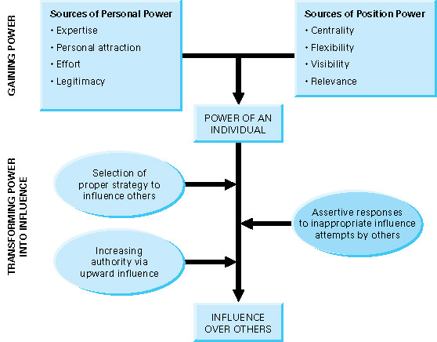
Model of Influence and Power
Insert Figure 5-2

Slide 36
“Far better to conceive of power as consisting in part of the knowledge of when not to use all the power you have … Whoever knows how to restrain and effectively release power finds … that power flows back to him”
A. Bartlett Giamatti

Slide 37
Behavioral Guidelines
Enhance personal power by improving your expertise, personal attraction, effort and legitimacy
Increase position power by improving your centrality, flexibility, visibility, and relevance

Slide 38
Behavioral Guidelines
Use reason, reciprocity, and retribution strategies appropriately and, when necessary, neutralize their use upon you
Learn to sell issues to your superiors

